Slide 1

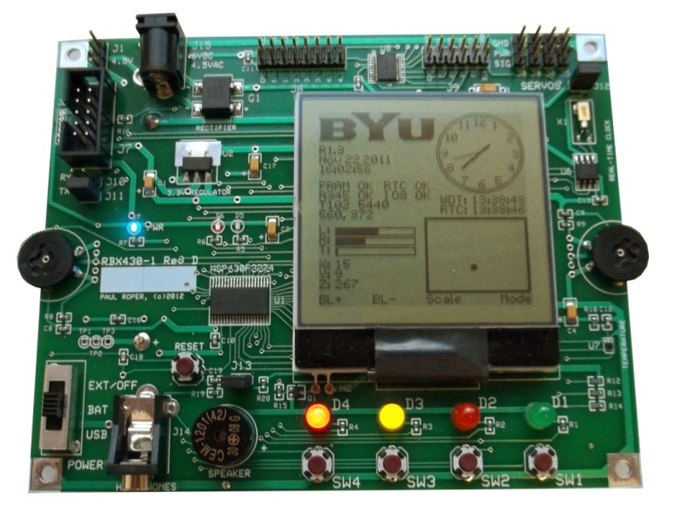
Lab 6a: Morse Code
http://www.youtube.com/watch?v=fZKVdxeWsyw

Slide 2
Learning Objectives
Morse Code
By completing the Morse Code Lab, a student will have:
Gained experience programming in assembly language.
Learned how to use single-step and break points to debug assembly code.
Written an interrupt service routine (ISR).
Used indirect addressing modes of registers as pointers.
Communicated with asynchronous routines using global variables.
Debounced a mechanical switch.
Demonstrated the use "callee-save" protocol when calling subroutines.
Linked symbolic values together from different program files.

Slide 3
Morse Code Lab
Morse Code
Write an MSP430 assembly program that communicates a message in Morse Code using an LED and a transducer (magnetic speaker).
Use a Watchdog Interrupt Service Routine (ISR)
Configure the watchdog as an interval timer.
Pulse width modulate (PWM) the speaker to create a tone.
Turn the red LED on for DOTs and Dashes.
Toggle the green LED on and off at one second intervals.
Use a .string assembler primitive to store the message.
Assess Dot and Dash codes from an external file.
Use Switch #1 to turn the tones on and off.

Slide 4
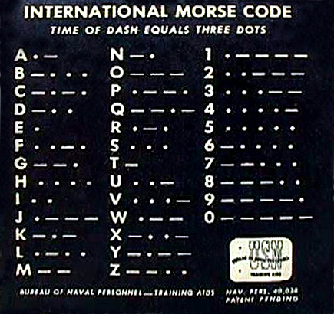
Morse Code
Morse Code
The word PARIS is the standard to determine Morse Code speed.
Each dit (dot) is one element,
Each dah (dash) is three elements,
Intra-character spacing is one element,
Inter-character spacing is three elements,
and inter-word spacing is seven elements.
PARIS is exactly 50 elements
If you send PARIS 5 times in a minute (5 WPM) you have sent 250 elements.
250 elements into 60 seconds per minute = 240 milliseconds per element.
13 words-per-minute is one element every 92.31 milliseconds.
•••• • • •• • •• • • • • •• ••

Slide 5
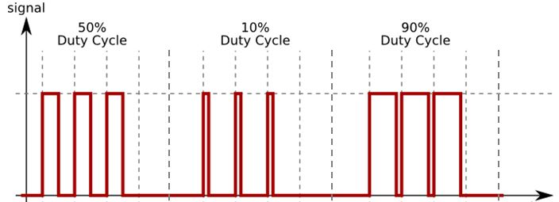
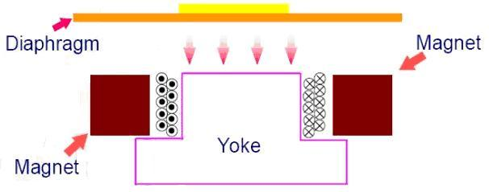
PWM
Morse Code
Time
Loud
Soft
Soft
tst.b &PWM_ON
is equivalent to
cmp.b #0,&PWM_ON
; Watchdog ISR -------------------------------------------
WDT_ISR: tst.b &PWM_ON ; PWM speaker?
jeq WDT_02 ; n
xor.b #0x20,&P4OUT ; y, use 50% PWM
WDT_02:

Slide 6
Watchdog PWM
Morse Code
.cdecls C,"msp430.h" ; include c header
.bss PWM_ON,1 ; PWM on flag
.text ; program section
start: mov.w #0x0300,SP ; initialize stack pointer
mov.w #WDT_MDLY_0_5,&WDTCTL ; WDT interval = 0.5 ms
mov.b #WDTIE,&IE1 ; enable WDT interrupt
bis.b #0x20,&P4DIR ; P4.5 output(speaker)
mov.b #1,&PWM_ON ; turn PWM on
bis.w #LPM0|GIE,SR ; enable interrupts / sleep
jmp $ ; (should never get here!)
; Watchdog ISR -----------------------------------------------------------
WDT_ISR: tst.b &PWM_ON ; PWM?
jeq WDT_02 ; n
xor.b #0x20,&P4OUT ; y, use 50% PWM
WDT_02: reti ; return from interrupt
.sect ".int10"
.word WDT_ISR ; Watchdog ISR
.sect ".reset"
.word start ; PUC RESET ISR
.end
Global Variable
PWM speaker (toggle P4.5) when PWM_ON is non-zero
(50% duty cycle)

Slide 7
Morse Code
morse_codes.asm
.def numbers
.def letters
.def DOT,DASH,END
morse_codes.asm
morse.asm
.ref numbers
.ref letters
.ref DOT,DASH,END
message: .string "ABC"
.byte 0
loop: mov.w #message,r4
lp02: mov.b @r4+,r5
sub.w #'A',r5
add.w r5,r5
mov.w letters(r5),r5
lp10: mov.b @r5+,r6
cmp.b #DOT,r6
jeq doDot
...
jmp lp10
END .equ 0
DOT .equ 1
DASH .equ 2
numbers:
DASH
DASH
DASH
DASH
DASH
END
DOT
DASH
DASH
DASH
DASH
END
DOT
DOT
DASH
DASH
DASH
END
...
...
letters:
DOT
DASH
END
DASH
DOT
DOT
DOT
END
DASH
DOT
DASH
DOT
END
...
...

Slide 8
morse.asm
Morse Code
System equates:
Clock speed, interrupts per second, etc.
; System equates --------------------------------------------------------------
.cdecls C,"msp430.h" ; include c header
myCLOCK .equ 1200000 ; 1.2 Mhz clock
WDT_CTL .equ WDT_MDLY_0_5 ; WD configuration (Timer, SMCLK, 0.5 ms)
WDT_CPI .equ 500 ; WDT Clocks Per Interrupt (@1 Mhz, 500 us)
WDT_IPS .equ myCLOCK/WDT_CPI ; WDT Interrupts Per Second
STACK .equ 0x0600 ; top of stack
; External references ---------------------------------------------------------
.ref numbers ; codes for 0-9
.ref letters ; codes for A-Z
; numbers--->N0$--->DASH,DASH,DASH,DASH,DASH,END ; 0
; N1$--->DOT,DASH,DASH,DASH,DASH,END ; 1
; ...
; N9$--->DASH,DASH,DASH,DASH,DOT,END ; 9
;
; letters--->A$---->DOT,DASH,END ; A
; B$---->DASH,DOT,DOT,DOT,END ; B
; ...
; Z$---->DASH,DASH,DOT,DOT,END ; Z
; 5 WPM = 60 sec / (5 * 50) elements = 240 milliseconds per element.
; element = (WDT_IPS * 6 / WPM) / 5
ELEMENT .equ WDT_IPS*240/1000
; Global variables ------------------------------------------------------------
.bss beep_cnt,2 ; beeper flag
.bss delay_cnt,2 ; delay flag
External references to number and letter tables
Let the assembly do your calculations!!
Global variables
beep_cnt => PWM ON
delay_cnt => timer

Slide 9
morse.asm
Morse Code
; Program section -------------------------------------------------------------
.text ; program section
message: .string "PARIS" ; PARIS message
.byte 0
.align 2 ; align on word boundary
start: mov.w #STACK,SP ; initialize stack pointer
mov.w #WDT_CTL,&WDTCTL ; set WD timer interval
mov.b #WDTIE,&IE1 ; enable WDT interrupt
bis.b #0x20,&P4DIR ; set P4.5 as output (speaker)
clr.w &beep_cnt ; clear counters
clr.w &delay_cnt
bis.w #GIE,SR ; enable interrupts
; output 'A' in morse code (DOT, DASH, space)
loop: mov.w #ELEMENT,r15 ; output DOT
call #beep
mov.w #ELEMENT,r15 ; delay 1 element
call #delay
mov.w #ELEMENT*3,r15 ; output DASH
call #beep
mov.w #ELEMENT,r15 ; delay 1 element
call #delay
mov.w #ELEMENT*7,r15 ; output space
call #delay ; delay
jmp loop ; repeat
Put your Morse Code message here…
Access each letter/number of your message and output to speaker with appropriate spaces between characters, words, and message.

Slide 10
morse.asm
Morse Code
beep subroutine turns on buzzer and waits for beep_cnt to clear
; beep (r15) ticks subroutine -------------------------------------------------
beep: mov.w r15,&beep_cnt ; start beep
beep02: tst.w &beep_cnt ; beep finished?
jne beep02 ; n
ret ; y
; delay (r15) ticks subroutine ------------------------------------------------
delay: mov.w r15,&delay_cnt ; start delay
delay02: tst.w &delay_cnt ; delay done?
jne delay02 ; n
ret ; y
; Watchdog Timer ISR ----------------------------------------------------------
WDT_ISR: tst.w &beep_cnt ; beep on?
jeq WDT_02 ; n
sub.w #1,&beep_cnt ; y, decrement count
xor.b #0x20,&P4OUT ; beep using 50% PWM
WDT_02: tst.w &delay_cnt ; delay?
jeq WDT_10 ; n
sub.w #1,&delay_cnt ; y, decrement count
WDT_10: reti ; return from interrupt
; Interrupt Vectors -----------------------------------------------------------
.sect ".int10" ; Watchdog Vector
.word WDT_ISR ; Watchdog ISR
delay subroutine waits for delay_cnt to clear
WDT_ISR PWM speaker while beep_cnt is non-zero
WDT_ISR also decrements delay_cnt when non-zero

Slide 11
Steps 1 & 2
Validate provided code:
Create an "Empty Assembly-only Project" for the MSP430F2274 using Code Composer Studio. (Delete main.asm if defined.)
Download the lab assembly files morse.asm and morse_codes.asm. Add them to your lab project.
Assemble and run the program on your development board. Verify that the letter 'A' (DOT DASH) is output by the speaker before proceeding.
Add instructions to the Watchdog ISR to turn the red LED on during a tone and off when not pulse width modulating the speaker. Also add code to toggle the green LED on and off at one second intervals. Test!

Slide 12
Step 3
Replace the "output DOT" lines of code with a call to a subroutine doDOT and the "output DASH" lines of code with a call to a subroutine doDASH. Write the subroutines doDot and doDASH. Assemble and test.
; output 'A' in morse code
loop: mov.w #ELEMENT,r15
call #beep
mov.w #ELEMENT,r15
call #delay
mov.w #ELEMENT*3,r15
call #beep
mov.w #ELEMENT,r15
call #delay
. . .
; output 'A' in morse code
loop: call #doDot
call #doDash
. . .
doDot: push r15
mov.w #ELEMENT,r15
call #beep
mov.w #ELEMENT,r15
call #delay
pop r15
ret
Remember, that all subroutines must observe a callee-save protocol. Save and restore all registers used by the subroutine on the stack.

Slide 13
Step 4
Re-write the main loop to access the message characters one at a time using the indirect auto-increment source addressing mode (@Rn+).
Use the indexed source addressing mode to index into the tables of letter word pointers to get a pointer to the Morse Code element bytes (xxxx(Rn)).
Compare code bytes with DOTs and DASHes and output the corresponding Morse Code elements for each letter of the message.
.ref letters ; codes for A-Z
loop: mov.w #message,r4 ; point to message
loop02: mov.b @r4+,r5 ; get character
sub.b #'A',r5 ; make 0-25
...
add.w r5,r5 ; make word index
mov.w letters(r5),r5 ; get pointer to codes
loop10: mov.b @r5+,r6 ; get DOT, DASH, or END
cmp.b #DOT,r6 ; dot?
...
jmp loop10

Slide 14
Step 4…
char message[6] = "APPLE";
message: .string
A
P
P
L
E
∅
char* letters[26];
letters:
1
2
0
Instructions | r4 | r5 | r6
mov.w #message,r4
mov.b @r4+,r5
sub.b #'A',r5
add.w r5,r5
mov.w letters(r5),r5
mov.b @r5+,r6
2
1
1
1
0
2
1
2
1
0
'A'
2
1
1
0
0
1
0
0
...
1
1
2
1
0
1

Slide 15
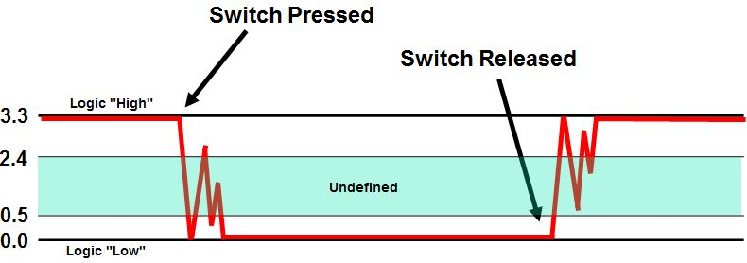
Steps 5 & 6
Add code to process numeric characters as well as letters.
Debounce Switch #1 to toggle the speaker on and off. (Leave the red LED outputting the Morse Code.)
.ref numbers ; codes for 0-9
; numbers--->N0$--->DASH,DASH,DASH,DASH,DASH,END ; 0
; N1$--->DOT,DASH,DASH,DASH,DASH,END ; 1
; ...
; N9$--->DASH,DASH,DASH,DASH,DOT,END ; 9

Slide 16
Watchdog Switch Debounce
Switch Debounce
.cdecls C,"msp430.h"
.bss WDT_dcnt,2 ; WDT second counter
.bss switches,2 ; switches
.text
RESET: mov.w #0x0600,SP ; init stack pointer
mov.w #WDT_MDLY_8,&WDTCTL ; WDT SMCLK, 8 ms (@1 Mhz)
bis.b #WDTIE,&IE1 ; enable WDT interrupt
clr.w WDT_dcnt ; clear debounce counter
bis.b #0x0f,&P4DIR ; set P4.0-3 as outputs
bic.b #0x0f,&P1DIR ; set P1.0-3 as inputs
bis.b #0x0f,&P1OUT ; pull-up
bis.b #0x0f,&P1REN ; enable pull-ups
bis.b #0x0f,&P1IES ; high to low transition
bis.b #0x0f,&P1IE ; enable interrupts
mainloop: bis.w #LPM0|GIE,SR ; enable interrupts/goto sleep
xor.b switches,&P4OUT ; output (toggle) P4.0-3
jmp mainloop
; Port 1 ISR --------------------------------------------------------------
DEBOUNCE .equ 5 ; debounce count (~40 ms)
P1_ISR: bic.b #0x0f,&P1IFG ; put its hand down
mov.w #DEBOUNCE,WDT_dcnt ; reset debounce counter
reti
; Watchdog ISR ------------------------------------------------------------
WDT_ISR: tst.w WDT_dcnt ; debouncing?
jeq WDT_02 ; n
sub.w #1,WDT_dcnt ; y, decrement counter, 0?
jne WDT_02 ; n
mov.b &P1IN,switches ; y, read switches
xor.b #0x0f,switches ; positive assertion
and.b #0x0f,switches ; mask low 4 bits (switches)
bic.b #LPM0,0(SP) ; exit low power mode (wake up)
WDT_02: reti ; return from interrupt
.sect ".int02"
.word P1_ISR ; Port 1 ISR
.sect ".int10
.word WDT_ISR ; Watchdog ISR
.sect ".reset"
.word RESET ; RESET ISR
.end
Configure Switches:
High to Low
Pull-ups
Enable interrupts
Port 1 ISR
For each bounce, reset debounce counter
Watchdog ISR
Decrement WDT_cnt (if non-zero), read switches and wakeup main routine.
Port 1 interrupt vector

Slide 17
Morse Code Requirements
Morse Code
2 points | A Watchdog Timer Interrupt Service Routine (ISR) creates Morse Code DOTs, DASHes, spaces using a speaker and red LED (D6). The ISR also toggles the green LED (D5) on and off every second.
2 points | Your machine repeatedly outputs the message "HELLO CS 124 WORLD " at a default rate of 5 words per minute (193 elements @5 WPM = approximately 46.32 seconds). Each DOT is one element, each DASH is three elements, intra-character spacing is one element, inter-character spacing is three elements, and inter-word spacing is seven elements.
2 points | The output message is stored in program memory using the .string assembler directive and accessed character by character using an indirect auto-increment assembly instruction. (Allowable characters include A-Z and 0-9.) The characters are translated to DOTs and DASHes using a table defined in an external assembly file.
2 points | Switch #1 (SW1) generates a Port 1 interrupt. The Watchdog ISR debounces the switch which turns the speaker on and off.
1 point | All program constants are defined using the .equ assembly directive. All subroutines use correct callee-save protocol. Only .bss section variables (not registers) are used to pass values between your main program and interrupt service routines (ie. ISRs are also callee-save subroutines).

Slide 18
Morse Code Requirements
Morse Code
Bonus Points:
+1 point | Passed off with a TA at least one day early. (No timestamps please!)
+1 point | The MSP430 enters low power mode until the Watchdog Timer ISR finishes either a dot, dash or silent element.
+2 points | Using interrupts, pressing Switch #2 (SW2) decreases the output speed of your Morse Code Machine by 1 word per minute. Pressing Switch #3 (SW3) increases the speed of your machine by 1 word per minute. The output speed is displayed in the LEDs (D1-D4). (Do the calculations in the switch and watchdog ISRs.)
-1 points | For each school day late. (Timestamps may be used to verify completion time.)

Slide 19
How to Code Assembler

Slide 20
How To Code Assembler…
Coding Assembler
Understand the problem (obviously)
Until you are comfortable in assembly, (and even afterwards), write out your solution in something familiar
English
Flowchart
Pseudo-code
Java, C, Ruby – the pseudo-code doesn’t really matter!
Then, translate to assembler

Slide 21
Three Basic Constructs
Coding Assembler

Slide 22
if-then-else
Coding Assembler
if-then-else
cmp.w #1,buzzerON ;
jne myElse ;
xor.b #0x20,&P4OUT ;
bis.b #0x02,&P1OUT ;
jmp myNext ;
myElse: ;
bic.b #0x02,&P1OUT ;
;
myNext: ;
if (buzzerON == 1)
{
pulse_buzzer();
turn_on_LED();
}
else
{
turn_off_LED();
}

Slide 23
switch / case
Coding Assembler
switch / case
cmp.w #DOT,myByte ;
jne sw_01 ;
call #do_dot ;
jmp sw_end ;
sw_01:
cmp.w #DASH,myByte ;
jne default ;
call #do_dash ;
jmp sw_end ;
;
default: ;
sw_end: ;
switch (myByte)
{
case DOT:
do_dot();
break;
case DASH:
do_dash();
break;
default:
}

Slide 24
for-loop
Coding Assembler
for-loop
.bss i,2 ;
mov.w #0,i ;
for_ck: cmp.w #10,i ;
jge for_done ;
call #do_dot ;
call #delay ;
call #do_dash ;
call #delay ;
add.w #1,i ;
jmp for_ck ;
for_done: ;
int i;
for(i=0; i<10; i++)
{
do_dot();
delay();
do_dash();
delay();
}

Slide 25
while
Coding Assembler
while loop…
TRUE .equ 1
.bss blink,2 ;
mov.w #TRUE,blink ;
while_loop: ;
cmp.w #0,blink ;
jeq while_done ;
call #LED_ON ;
call #delay ;
call #LED_OFF ;
call #delay ;
jmp while_loop ;
while_done: ;
#define TRUE 1
int blink = TRUE;
while (blink)
{
LED_ON();
delay();
LED_OFF();
delay();
}

Slide 26
